Slide 1
Social Dispersed Computing: Societal Scale Cyber-Physical Systems Applications, Challenges and Opportunities
Abhishek Dubey
Assistant Professor,
Computer Science and Electrical Engineering
Vanderbilt University
Senior Research Scientist,
Institute for Software Integrated Systems

Slide 2
Outline of this talk
We are going to review the application domain of data-driven smart and connected cyber-physical systems.

Slide 3
Outline of this talk
We are going to review the application domain of data-driven smart and connected cyber-physical systems.
Then we are going to review the key research challenges in this domain.

Slide 4
Outline of this talk
We are going to review the application domain of data-driven smart and connected cyber-physical systems.
Then we are going to review the key research challenges in this domain.
Finally, we are going to review a computation platform that our team is building that is enabling the design, deployment and management of these systems at scale.

Slide 5
Outline of this talk
We are going to review the application domain of data-driven smart and connected cyber-physical systems.
Then we are going to review the key research challenges in this domain.
Finally, we are going to review a computation platform that our team is building that is enabling the design, deployment and management of these systems at scale.
Towards the end, we are going to identify the future research questions that we are investigating.

Slide 6
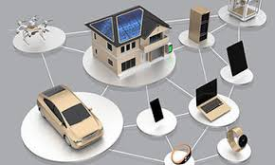
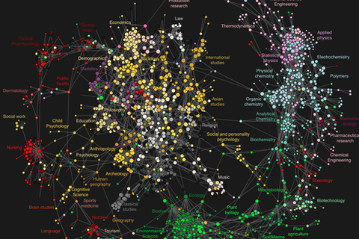
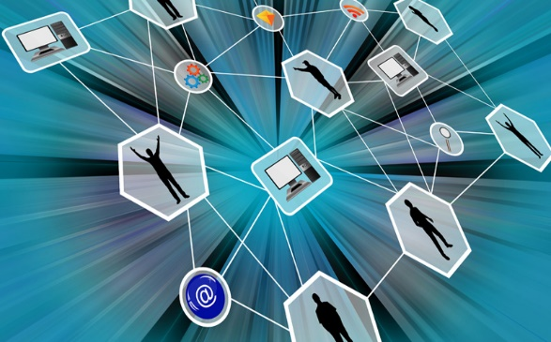
Outline of this talk
We are going to review the application domain of data-driven smart and connected cyber-physical systems.
Networked And Distributed Systems
Data Sciences
Social Sciences and Game Theory
These class of systems brings together the three different disciplines of engineering.

Slide 7
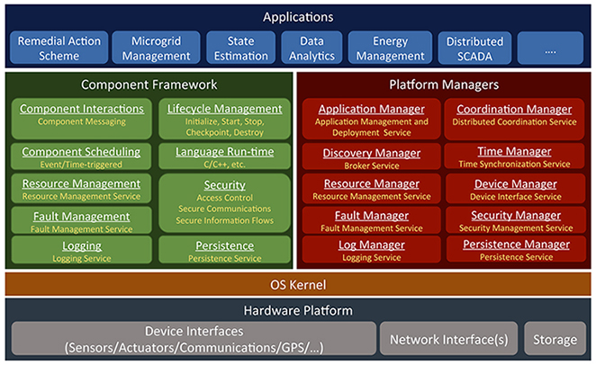
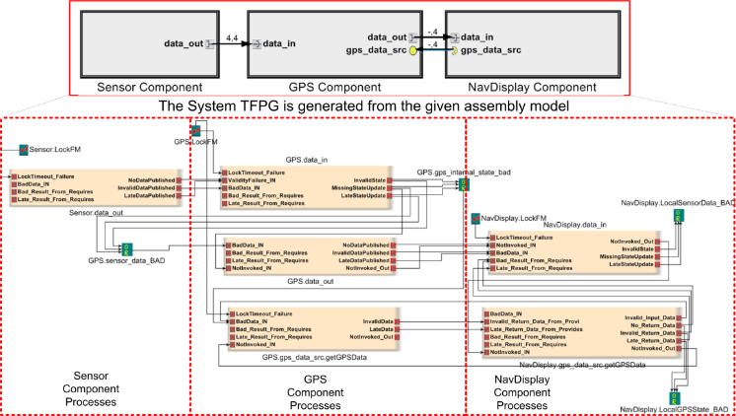
Outline of this talk
We are going to review the application domain of data-driven smart and connected cyber-physical systems.
We are going to focus on the area of distributed and networked systems and identify the key research challenges and new contributions.
New programming models and middleware
Fault Modeling and Diagnosis
Decentralized
Coordination

Slide 8
The emerging trend of decentralized societal-scale Cyber-physical Systems

Slide 9
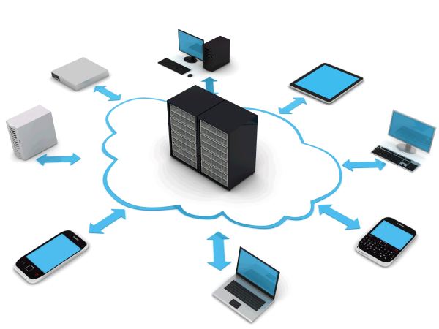

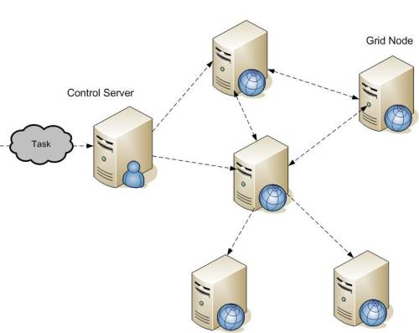
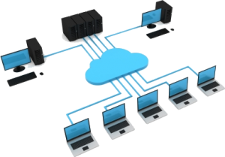
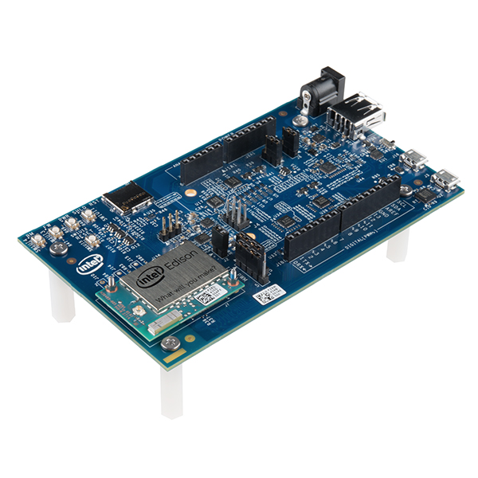
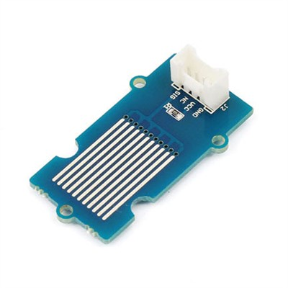
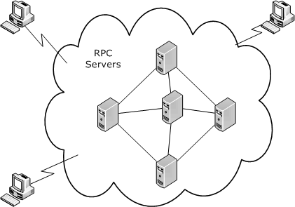
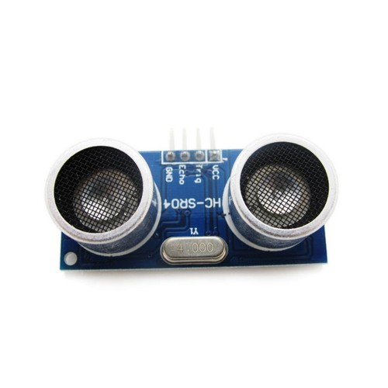
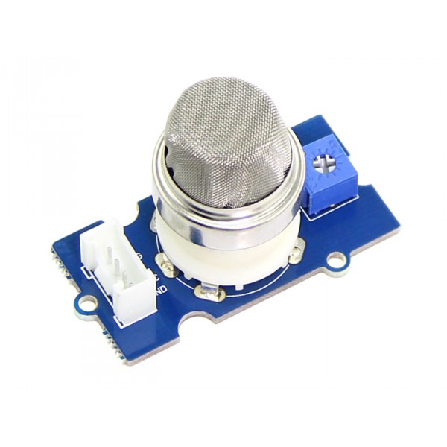
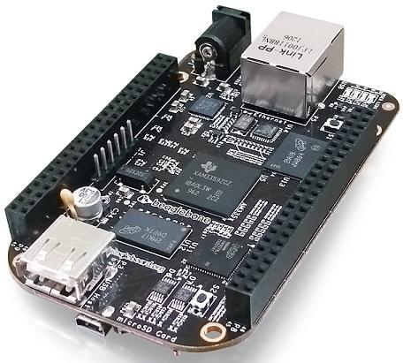
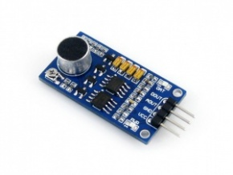
The computing revolution over the years
Ubiquitous Computing (mobile, IoT, IIoT)
Grid Computing
Decentralized Computing
Present
Late 2000s
Single Board Computers
Mid 2000s
Mid 1990s
Cloud Computing
Small Homogeneous Clusters
Notes:
IoT/IIoT: Devices that are connected to each other and connected to the Internet
Emerging trends: Advancement in edge computing devices have resulted in sophisticated and resourceful devices that are equipped with variety of sensors and actuators
E.g.: Intel Edison on Arduino with sensors from the Grove Starter Kit
Therefore, the future of Ubiquitous Computing is CP in nature. As such CPS will play an important role.
Smart cities are great exemplars of future of ubiquitous computing:
Comprises heterogeneous resources of varying domains (transportation, power grid, e.t.c..)
Resources vary from resc-constd edge devices with sensors/actuators to resourceful cloud instances
Resources can be dynamic and have distributed ownership
As such, traditional notion of CPS does not fit as is

Slide 10
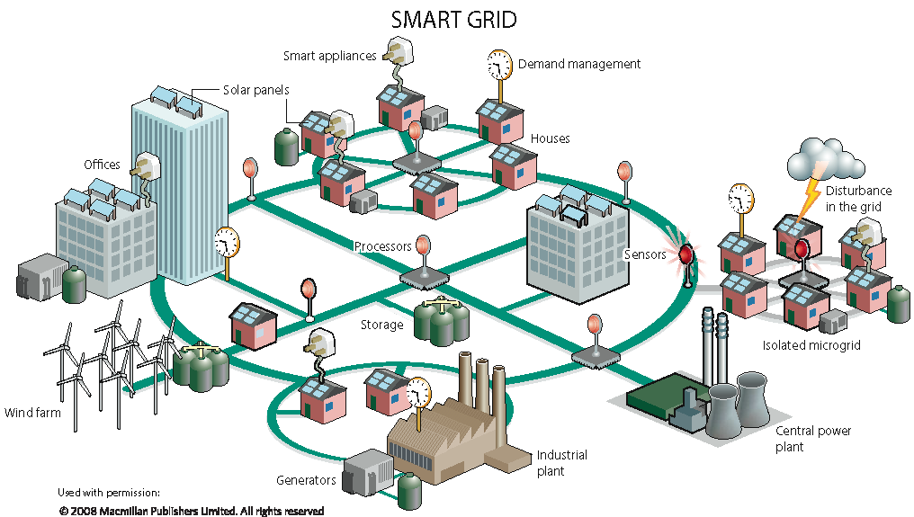
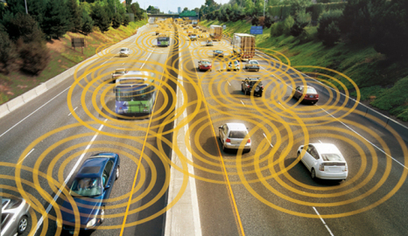

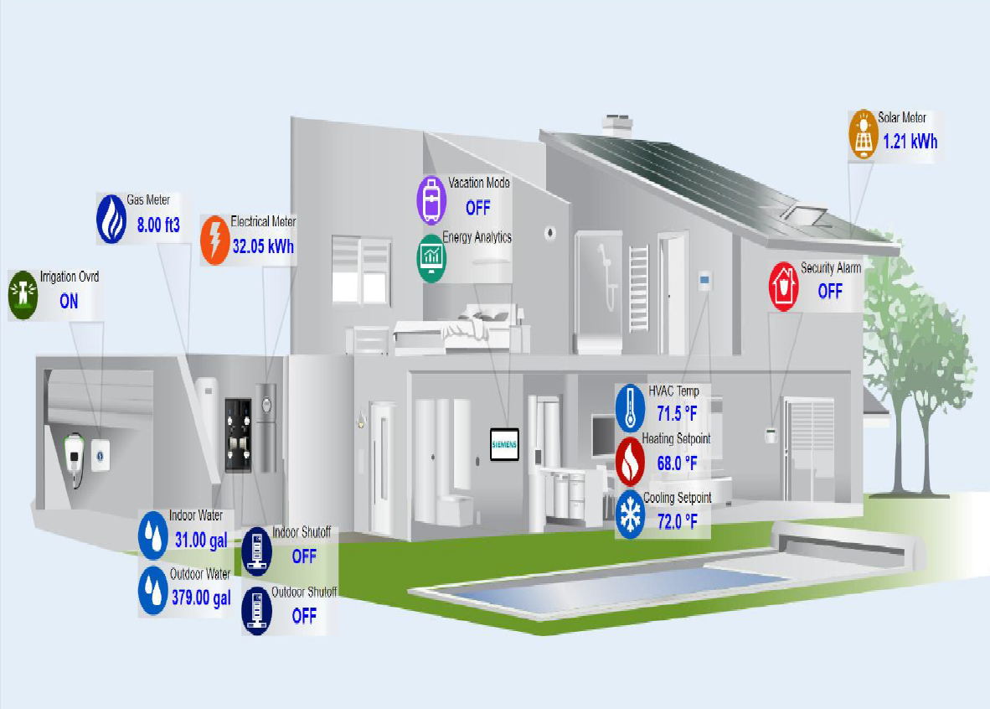
A New Industrial Revolution Is Unfolding
Microgrids
Transportation on
Health Care
Smart Buildings
Industrial Platforms (IoT, Fog Computing, Industrial Internet) has inspired huge interest in and enabled the development of Societal-Scale Cyber-Physical Systems (CPS).
Notes:
Each provider and each senior living center has their own information – what if people keep the information in their control – can keep control.

Slide 11
Societal-Scale Cyber-Physical Systems
Humans are “embedded intelligent agents”, human decision making is part of control loops: H-CPS
Massive societal implications trigger conflicting societal expectations and policies: Policy-aware system design
Complexity requires building systems with Learning Enabled Components: High-confidence system design with components that can learn
Networked And Distributed Systems
Data Sciences
Social Sciences and Game Theory
This requires research across three scientific disciplines

Slide 12
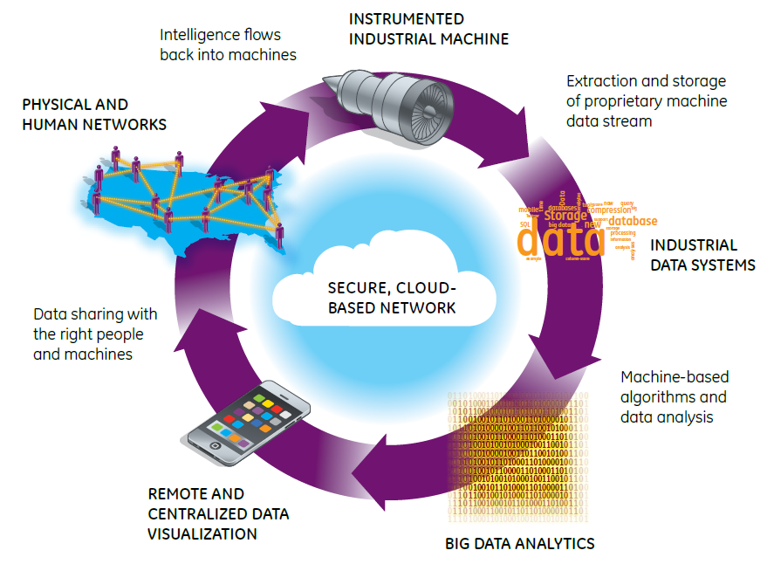

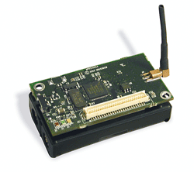
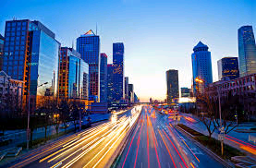
Deconstructing Societal-Scale Cyber-Physical Systems
Human Layer
Cities
Sensors
Smart Application Layer
Computation Platform Layer
Networking Layer
Physical System and Sensors

Slide 13
Deconstructing Societal-Scale Cyber-Physical Systems
Human Layer
Cities
Sensors
Data Streams
Smart Application Layer
Computation Platform Layer
Platform
Networking Layer
Physical System and Sensors

Slide 14
Deconstructing Societal-Scale Cyber-Physical Systems
Human Layer
Cities
Sensors
Data Streams
Smart Application Layer
Decision Support Systems
Platform
Networking Layer
Physical System and Sensors
Decision Support Systems: Big Data Analytics

Slide 15
Deconstructing Societal-Scale Cyber-Physical Systems
Human Layer
Cities
Sensors
Data Streams
Smart Application Layer
Decision Support Systems
Platform
Networking Layer
Physical System and Sensors
UI and Information Presentation
Decision Support Systems: Big Data Analytics

Slide 16
Deconstructing Societal-Scale Cyber-Physical Systems
Human Layer
Cities
Sensors
Human Networks
Data Streams
Smart Application Layer
Decision Support Systems
Data Sharing
Platform
Networking Layer
Physical System and Sensors
UI and Information Presentation
Decision Support Systems: Big Data Analytics

Slide 17
Let us consider an example

Slide 18
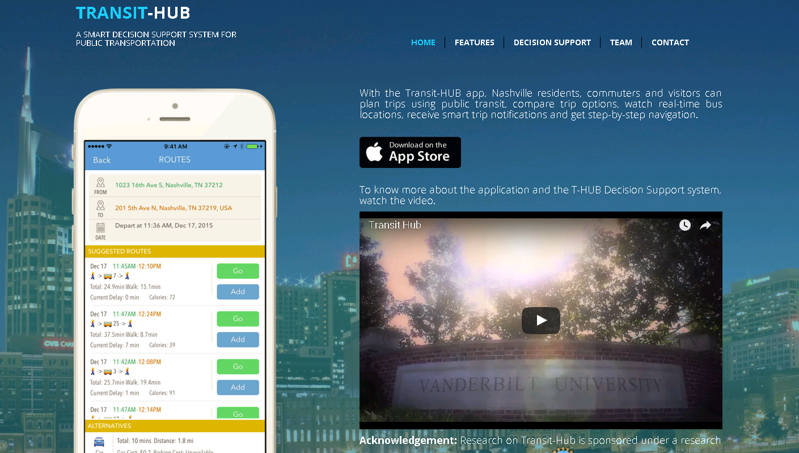

Slide 19



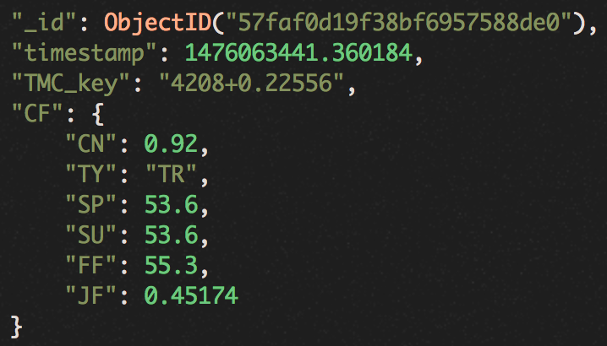

Transit-Hub
Data Aggregation
Contextual Anomaly Detection
Applications and Services
Smart
Phones
Data Formatting
Converting to the same format
Long-term Model
Stacked Convolutional Neural Networks
Explaining non-recurrent traffic patterns for large areas
Real-time Delay Prediction
For visitors and travelers
Data Cleaning
Get rid of errors and noises
Augmented Traffic Dataset
For third party applications
Roadside
Sensors
Data Processing
Normalization
Balancing
Aggregation
Short-term Model
Stacked LSTM encoder decoder
Identifying traffic anomaly due to events, e.g., accidents
Predicting traffic conditions
Service Alerts
For visitors and travelers
On-vehicle
Devices
Service Analysis and Optimization
For city planners
Traffic
Data APIs

Slide 20
Consequences
The next decade is (probably) about
The merge of AI and CPS
Spread of societal-scale CPS
Autonomy everywhere
Cities
Sensors
Human Networks
Data Streams
Challenges
Can societies follow the speed of change?
Can we make a dent on the security problems?
Can we keep the future systems assured?
Can we handle the volume and velocity of data required to create these systems.
Data Sharing
Platform
UI and Information Presentation
Decision Support Systems: Big Data Analytics

Slide 21
Design and Analysis of Societal-Scale CPS
Human Users/Regulators
Policy and Data –Driven Analysis Design
Control modalities
Ops. and security policies
Service metrics
Functional req.,
Policies
Utilities,
risk, cost
CPS Services (Connected Vehicles, Grid,..)
Platform Integration and Interface design
Service to platform
mapping,
Sensing and actuation
Mapping/
Configuration
Platform Services
Physical Systems/Resources
System Integration and Interface Design
Approach: Model and Component based design

Slide 22
Design and Analysis of Societal-Scale CPS
Human Users/Regulators
Incentive engineering
Mechanism design
Game Theory
Control modalities
Ops. and security policies
Service metrics
Functional req.,
Policies
Utilities,
risk, cost
CPS Services (Connected Vehicles, Grid,..)
Functional design
Information flows Security constraints
Platform mapping
Timing constraints
Service to platform
mapping,
Sensing and actuation
Mapping/
Configuration
Platform Services
Physical Systems/Resources
Physical dynamics
Platform properties
Resource constraints
Approach: Model and Component based design

Slide 23
Let us focus on the platform design challenge Mapping: Application to the computing continuum

Slide 24


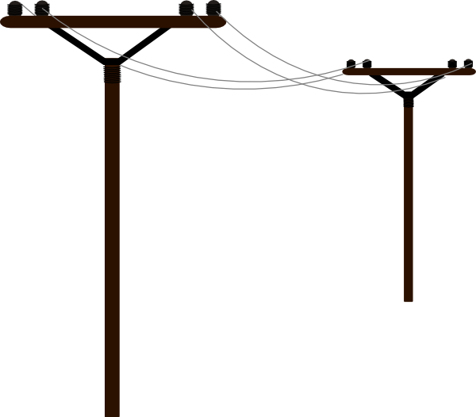





The computing continuum
Cloud
Resource availability
Fog
(Fog nodes)
Data source proximity
Edge (Sensors, Actuators)
Notes:
A fluid and complete IoT architecture must combine edge, fog, and cloud computing paradigms.
Lower the data source proximity, further away the resources are from data source and therefore higher latency
What if fog nodes deployed in the physical environment? Are they edge or fog? They are fog as long as they don’t have sensors or actuators, and only perform computation. Something like an Intel Edison can be considered both.

Slide 25
The computing continuum
Non real-time applications
Long running, computation heavy analytics
E.g.: Daily weather forecast to determine power generation in wind farms
Cloud
Soft real-time applications
Applications that deal with sensitive data
E.g.: Hourly weather forecast to adjust power generation estimation in wind farms
Fog
(Fog nodes)
Edge (Sensors, Actuators)

Slide 26
The computing continuum
Cloud
Desired behavior
Disturbances
Controller
Actuator
Physical System
Cyber
Observed
behavior
Sensors
Fog
(Fog nodes)
Closed-loop control applications
Real-time requirements
Mission-critical
Cyber-Physical Systems
E.g.: Different control loops that are part of a wind turbine
Edge (Sensors, Actuators)
Requirement: Transition towards next-generation of CPS that are not developed as isolated vertical silos
Notes:
Pitch control loop uses PID (Proportional Integral Derivative) controller to control pitch of turbine blades. Wind speed sensor used.
Future of edge computing requires transition from traditional CPS (isolated vertical silos with application lifecycle strictly tied to that of the underlying system) to next-generation CPS.
Next-generation CPS essentially requires us to view CPS as open, dynamic platforms that can host multiple applications simultaneously

Slide 27
Example: Transactive Energy

Slide 28

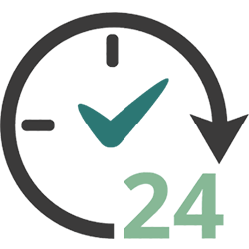



Goal: Map the Dispersed Societal Scale Applications on to the computing continuum without burdening the developers.
Management
Applications lifecycle not tightly-coupled with that of the underlying system
Managing lifecycle of remote, possibly dynamic, distributed applications
Initial deployment and Reconfiguration (maintenance, updates, failures)
Resilience
Ensuring availability of mission-critical functionalities for as long as possible
Resilient applications and system services
Remote deployment necessitates autonomous resilience mechanisms
Interoperability (Computation and Communication)
Heterogeneous computation models and communication middleware
Achieving computation model and middleware agnostic applications to maximize interoperability
Security
Authentication, Authorization, and Access control (AAA) mechanisms to ensure safety of data at rest and data in motion
Scalability
Solving all of the above challenges at scale (hardware and software)
Ensuring other services like time-coordination, device interfaces and message architecture is integrated without any problem.

Slide 29
Resilient Information Architecture Platform for Smart Systems

Slide 30
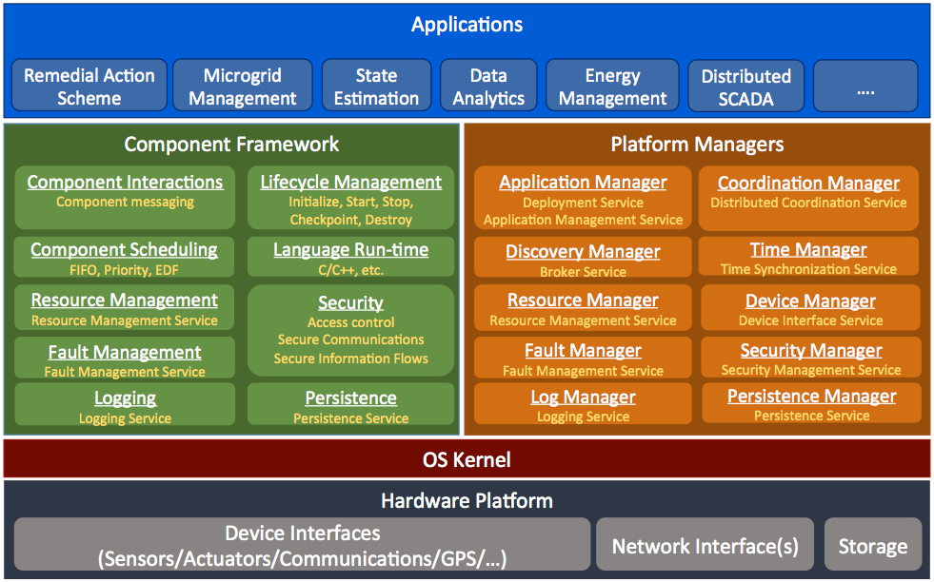
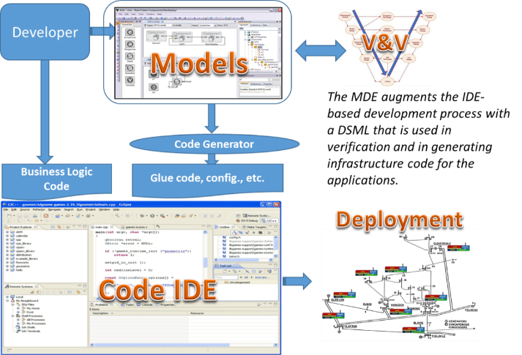
Overview – Key ideas
Resilient Information Architecture Platform for Smart Grid:
Foundation: A Robust, Trusted, Open Software Platform for Smart systems.
Tools: A Suite of Model-driven Development Tools for building and integrating software applications to run within the computing continnum.
Why?
Change the paradigm for smart CPS software development
Software Platforms reduce complexity and increase reliability of software applications by providing reusable technological building blocks
Model-driven development tools and processes automate the tedious parts of software development and provide a design-time framework for analysis of software systems – reducing errors

Slide 31
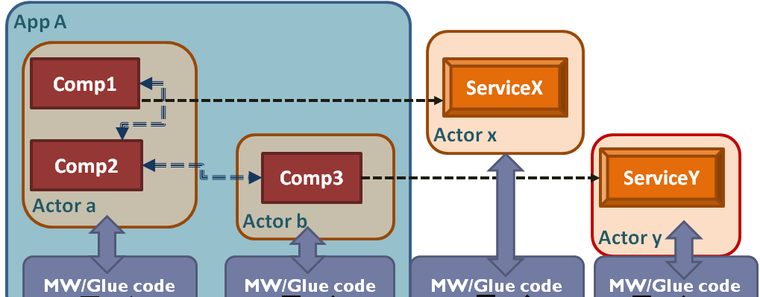
Actor Based Design
Actor-based design of applications
Apps are architected as one or more actors that share information via secure messaging
Actors encapsulate components, with well-defined interaction semantics
Actor’s resource needs are declared by developer, admitted by the system integrator; and enforced by the platform
Why?
The components encapsulate reusable functionality
The actor concept provides ‘units’ for computing activities, communication via secure information flows, resource usage, and fault tolerance

Slide 32
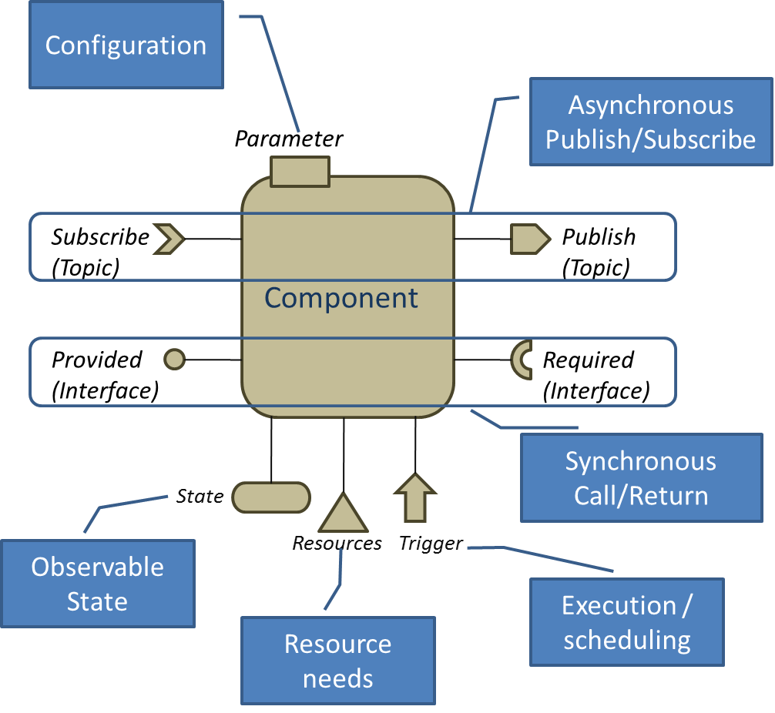
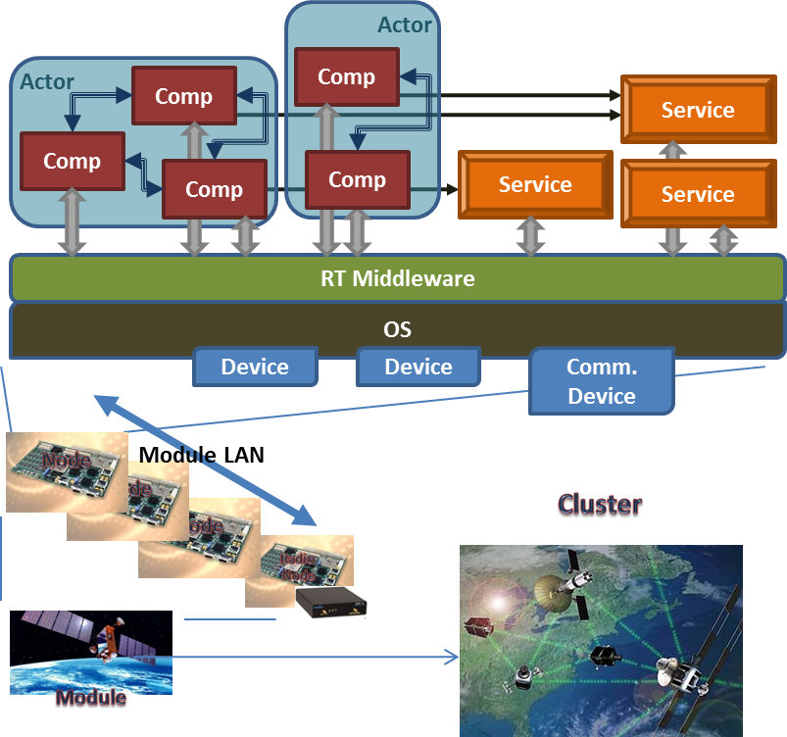
Strictly specified and monitored interaction semantics
Synchronous Interfaces: call/return
Periodic: time-triggered
Aperiodic: event-triggered
Asynchronous Interfaces: publish-subscribe
Periodic: time-triggered
Aperiodic: event-triggered
Other interfaces:
State: to observe component state variables
Resource: to monitor resource usage
Trigger: to monitor execution timing
Execution Model:
One activity at a time
Notes:
As I mentioned earlier, applications are constructed as a composition of components. Unlike regular operating systems, the applications were restricted to communicate through some basic patterns.
Their execution model for activities was also pre-determined. In some work not discussed here, one of the graduate students was able to take this model and create a set of tools that can predictively compute time of execution of application tasks and come up with conservative activity execution bounds to ensure deadlines are not missed.

Slide 33
Layered Fault Management
Actor
Layered Fault Management Principles:
Fault effects propagate to neighboring layers (up/down) via guaranteed behavior
Interactions between the layers are monitored and restricted
A lower layer can silent the layer above via the fault management interface (fail stop)
Guaranteed/
Assumed
Fault Models
Fault Management
Interface
Middleware
Guaranteed/
Assumed
Fault Models
Fault Management
Interface
C Library
Guaranteed/
Assumed
Fault Models
Fault Management
Interface
Operating System
Guaranteed/
Assumed
Fault Models
Fault Management
Interface
Hardware Layer
Notes:
The key idea is to make each layer robust such that it ensures that faults from the layer above it cannot propagate to a fault in the layer below. And the layer above can assume certain behavior about the layer below and if that fails, the layer below should inform the layer above.

Slide 34
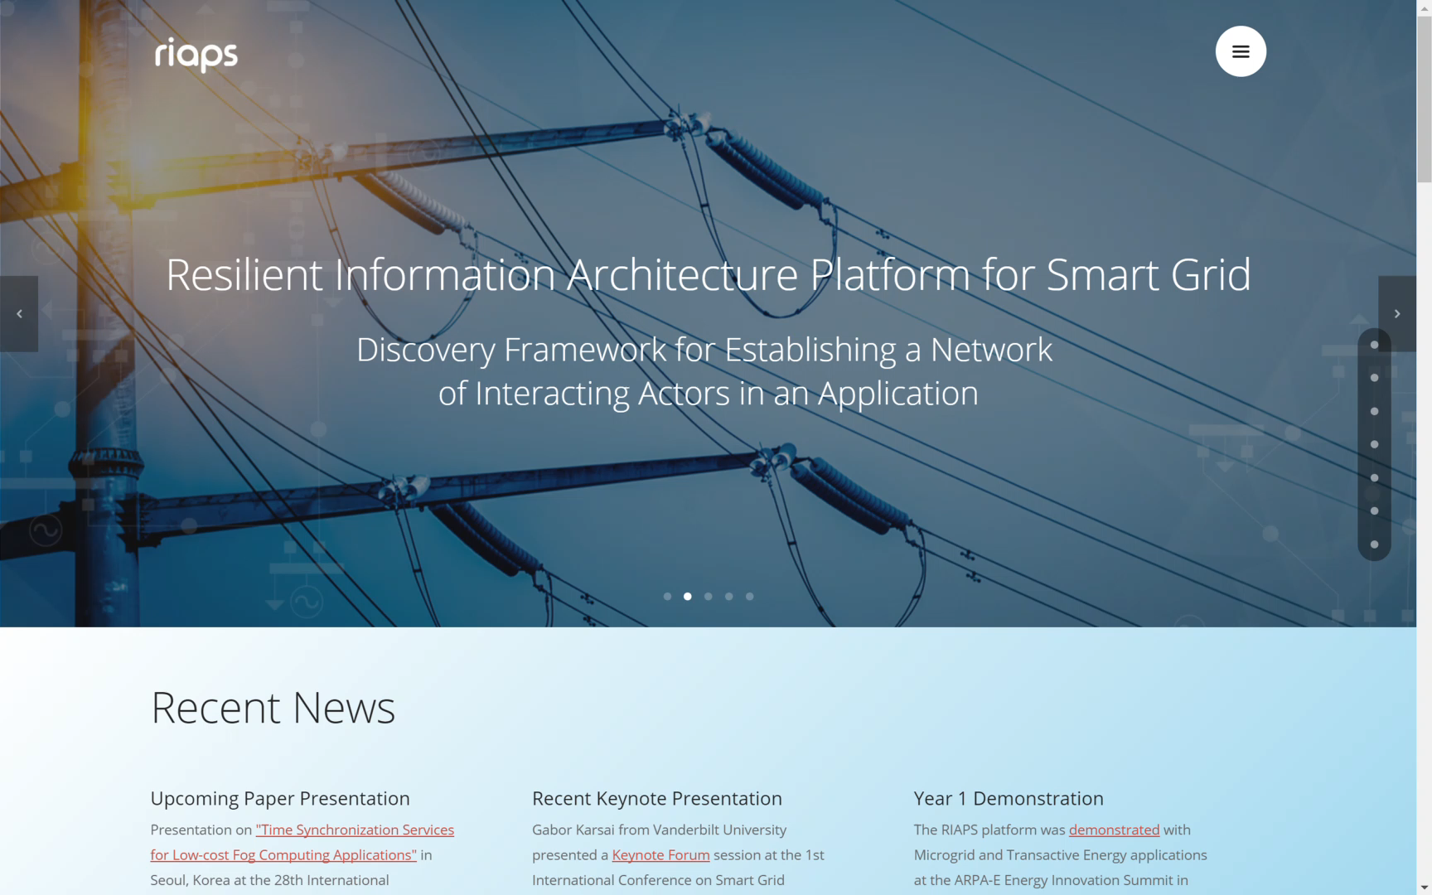
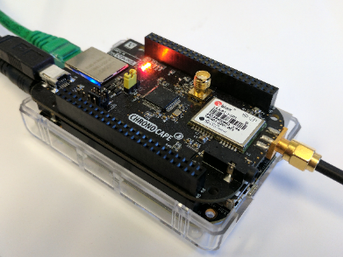
Application Programming Interfaces
Decentralized
Distributed
Sensing
Analysis
Control Applications

Slide 35
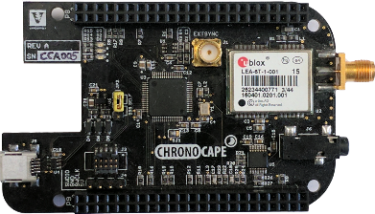
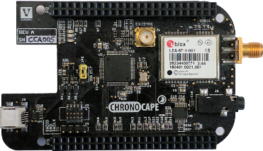
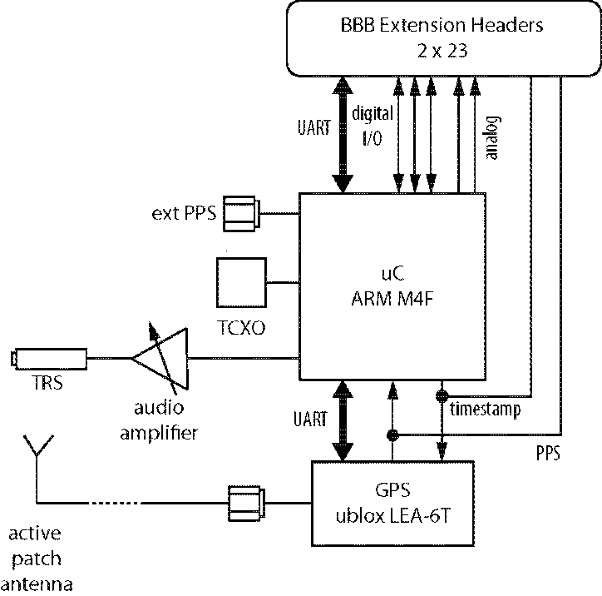
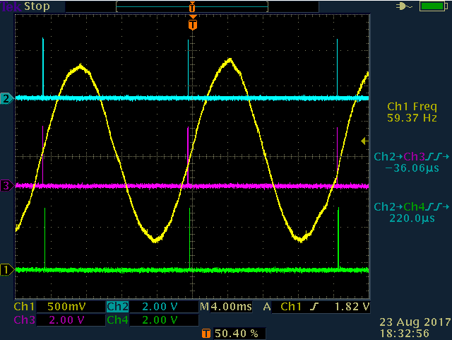
Application Programming Interfaces
Hardware Assisted High Precision Networked Time Synchronization
GPS/PTP/NTP

Slide 36
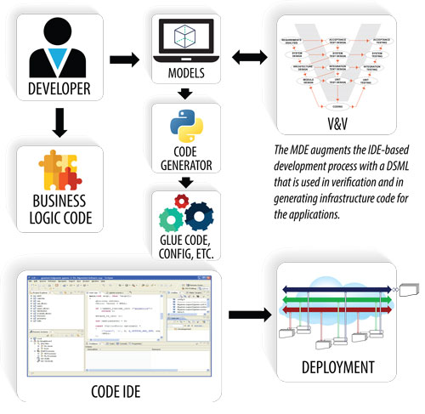
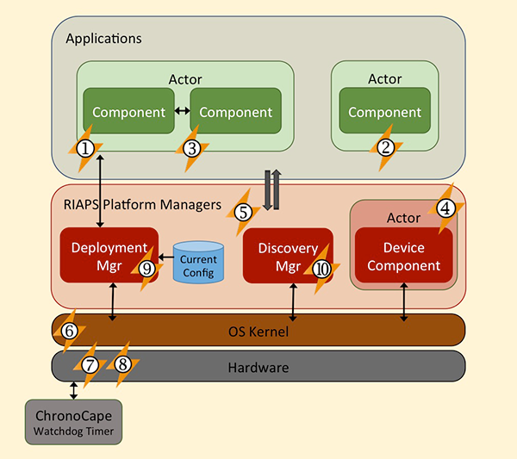
Distributed Fault Management Framework
Robust Development and Operation Framework

Slide 37
Example Application

Slide 38
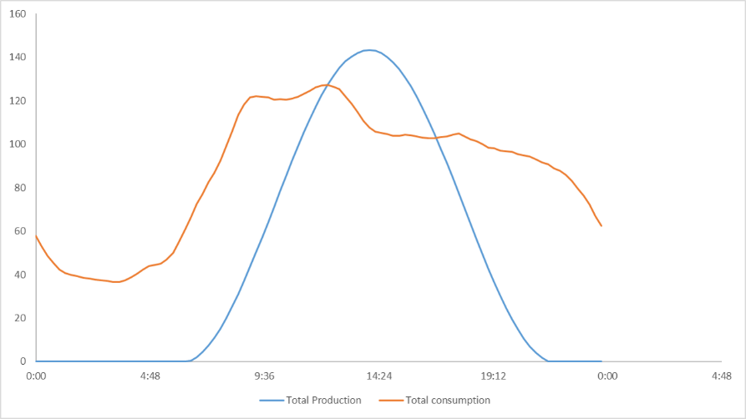
Transactive Energy
Participant 1
Energy Exchange
Reduces Dependence on the Grid
Participant 2
typical generation and consumption profile

Slide 39
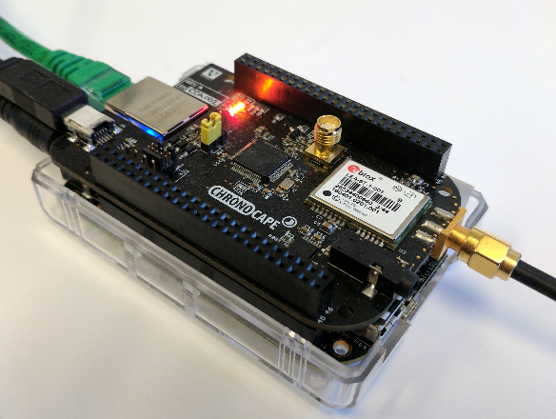
Transactive Energy System (Example Application)
We have developed PETra, a blockchain-based solution that enables consumers to trade energy without sacrificing their privacy and provides safety and security for the grid. It provides the following:
The node runs the necessary logic to participate in the trading
A RIAPS Node Participating in PETra-Enabled Transactive Energy Market

Slide 40
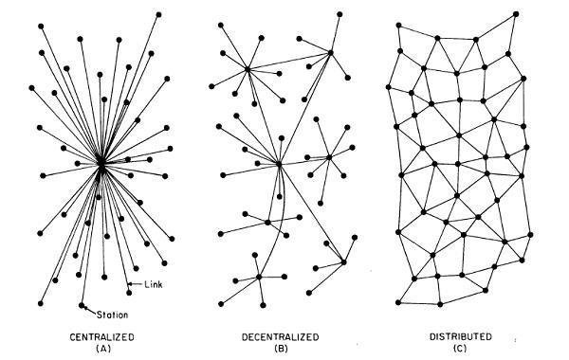
Summary
Reliability of our grid and electrical system depends upon the ability to operate as a collection of Microgrids
This requires sensing, control and actuation throughout the system.
Centralized computing will not be enough and therefore fog computing is an answer.
RIAPS provides the key building blocks required to build the applications.
However, more applications need to be constructed.
Visit http://riaps.isis.vanderbilt.edu to learn more
Network of transactive microgrids with limited role of distribution system operators

